Slide 1
IMAGE PROCESSING OF MEDICINAL PLANTS USING CONVOLUTIONAL NEURAL NETWORK
Presentation by
Neha m u (210701178)
Monika s (210701166)
Nithinpranao s k (210701180)

Slide 2
Problem statement
Traditional medicine has used medicinal plants for ages as all-natural
treatments for a wide range of illnesses. They include medicinal
bioactive substances that can be utilized to treat a variety of ailments.
The identification and characterisation of medicinal plants are of
increasing importance due to the rising demand for natural products
and the requirement for sustainable healthcare.

Slide 3
ABSTRACT
The use of convolutional neural networks (CNNs) for processing medicinal plant images is suggested by this study. The goal is to create a reliable system that can recognize and categorize different species of medicinal plants from photos. Preprocessing picture data, training CNN models, and assessing classification accuracy are all part of the implementation process. The outcomes show how well CNNs work at automating the identification procedure, which supports studies on medicinal plants and efforts to conserve them. During training, the CNN learns to extract discriminative features from plant images, enabling it to accurately classify them into different categories based on their medicinal properties or taxonomic characteristics. Transfer learning techniques may also be employed to enhance the model's performance, especially when dealing with limited training data.

Slide 4
INTRODUCTION
Throughout all cultures and eras, medicinal plants have been valued for their healing abilities, and they are the basis of traditional medical systems all around the world. These plants contain an abundance of bioactive substances, including flavonoids and alkaloids, each having specific therapeutic potential. The use of medicinal plants has been essential to human health and well-being from ancient treatments to contemporary medications. This study suggests using convolutional neural networks (CNNs) to process medicinal plant images as a solution to this problem. CNNs, a subclass of deep neural networks, have outperformed humans across a range of disciplines with unmatched success in image recognition tests.

Slide 5
METHODOLOGY
The study focuses on a comprehensive data collection process involving MORE THAN 2000 meticulously categorized photos of medicinal plants, representing 20 distinct species and capturing MEDICINAL PLANTS to ensure a thorough depiction of each species' visual traits. Plant specimens were carefully collected from their native habitats, including rare and unusual species, adding to the dataset's diversity. The photos, stored in JPEG format, were divided into training, validation, and testing subsets with an 80:20 ratio for training and validation, and random augmentation techniques like cropping and horizontal flipping were applied to achieve a consistent size of 256x256 pixels, further cropped to 224x224 pixels. The processed images ranged from 200KB to 500KB, ensuring high quality and consistency.
. This results in more precise and efficient classification, even when dealing with the complex and varied traits of medicinal plants, such as differences in leaf size, shape, color, and texture. CNNs handle these intricacies by capturing detailed patterns and variations within and between plant species, ensuring accurate classification. Additionally, CNNs are scalable and flexible, capable of managing large datasets efficiently, which is crucial as the number of labeled images of medicinal plants grows. Their architecture, comprising convolutional layers for feature extraction, pooling layers for reducing spatial dimensions, and fully connected layers for classification, makes CNNs invaluable tools for a wide range of applications in computer vision and beyond.

Slide 6
PROPOSED SYSTEM MODEL
A number of crucial processes are included in the suggested system model for processing medicinal plant images using TensorFlow and Convolutional Neural Networks (CNN). To assure uniformity and improve variability, a broad array of high-resolution photos of medicinal plants is first gathered and preprocessed. A CNN architecture is then created with the proper layers and approaches to avoid overfitting for tasks like object identification, segmentation, or classification. The CNN model is then trained using TensorFlow, perhaps utilizing transfer learning for better generalization, once the dataset has been divided into training, validation, and testing sets.
Detection API is utilized to create object detection models, and bounding boxes with annotations are used for training and assessment. In order to ensure adaptability and efficacy in supporting medicinal plant research, agriculture, or healthcare, the models are deployed using TensorFlow Serving or TensorFlow Lite for inference after training, integrated into pertinent applications or systems, and continuously improved based on new data and user feedback.

Slide 7
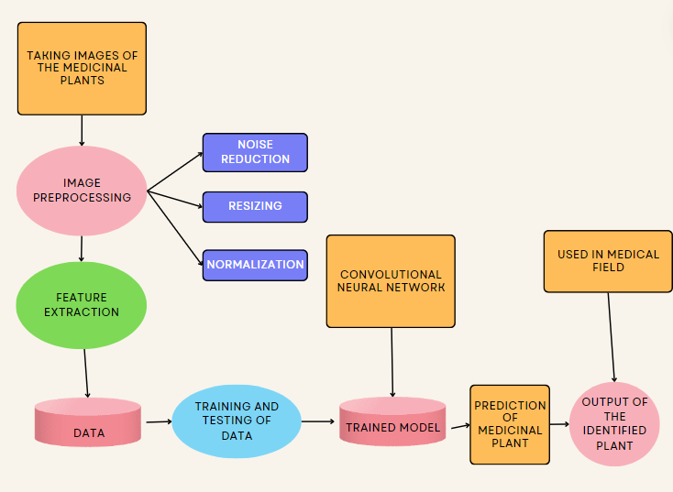
ARCHITECTURE DIAGRAM

Slide 8
The CNN architecture's learning rate and batch size are two hyperparameters that can be optimized using methods like grid search or random search to enhance performance. It is possible to investigate ensemble learning techniques to merge predictions from various CNN models, improving overall resilience and performance. The model's ability to handle challenging tasks like segmentation, object detection, and classification can be further enhanced by looking into different transfer learning techniques, multi-task learning frameworks, and attention mechanisms.

Slide 9

ACCURACY GRAPH FOR TRAINING AND VALIDATION
Once the training is completed, a graph depicting the training accuracy, validation accuracy, and 20 epochs is created. The validation accuracy is represented by the blue line, while the red line represents the training accuracy. The formula used to calculate accuracy is provided below

Slide 10
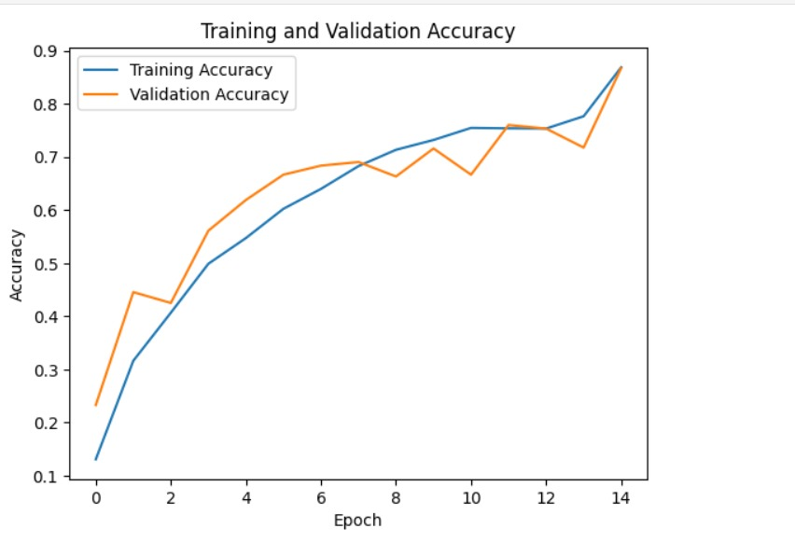
Accuracy Graph on Training Set and Validation

Slide 11
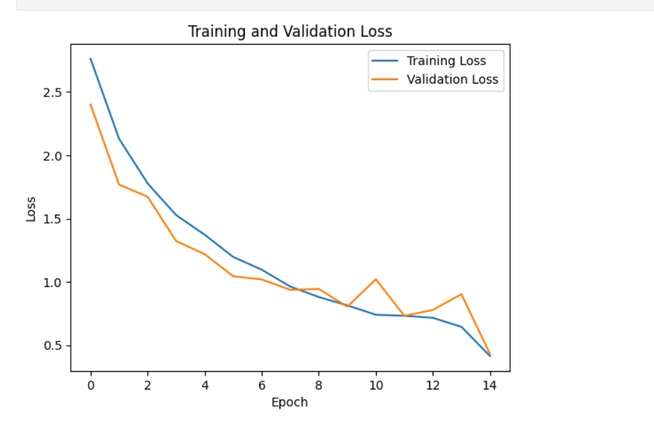
Loss graph on training and validation

Slide 12
ACCURACY OF THE MODEL
The model's accuracy in properly identifying medicinal plants from photos of their leaves is measured by this formula. While a lower accuracy score implies that the model might be making more mistakes in its predictions, a higher accuracy value shows that the model is making more accurate predictions.
A Convolutional Neural Network (CNN) model's accuracy graph, which is produced during the training and validation stages, offers important insights into the functionality and learning dynamics of the model. Typically, this graph shows the accuracy of training and validation over a number of training epochs, or iterations.

Slide 13
TRAINING OF THE MODEL
The model iteratively modifies its parameters depending on the training examples as it gains the ability to identify patterns and characteristics in the training data, thus increasing its accuracy. The graph's blue line, or training accuracy, indicates how well the model performs on the training set as training goes on. It displays how well the model was able to categorize or forecast labels for the training set.

Slide 14
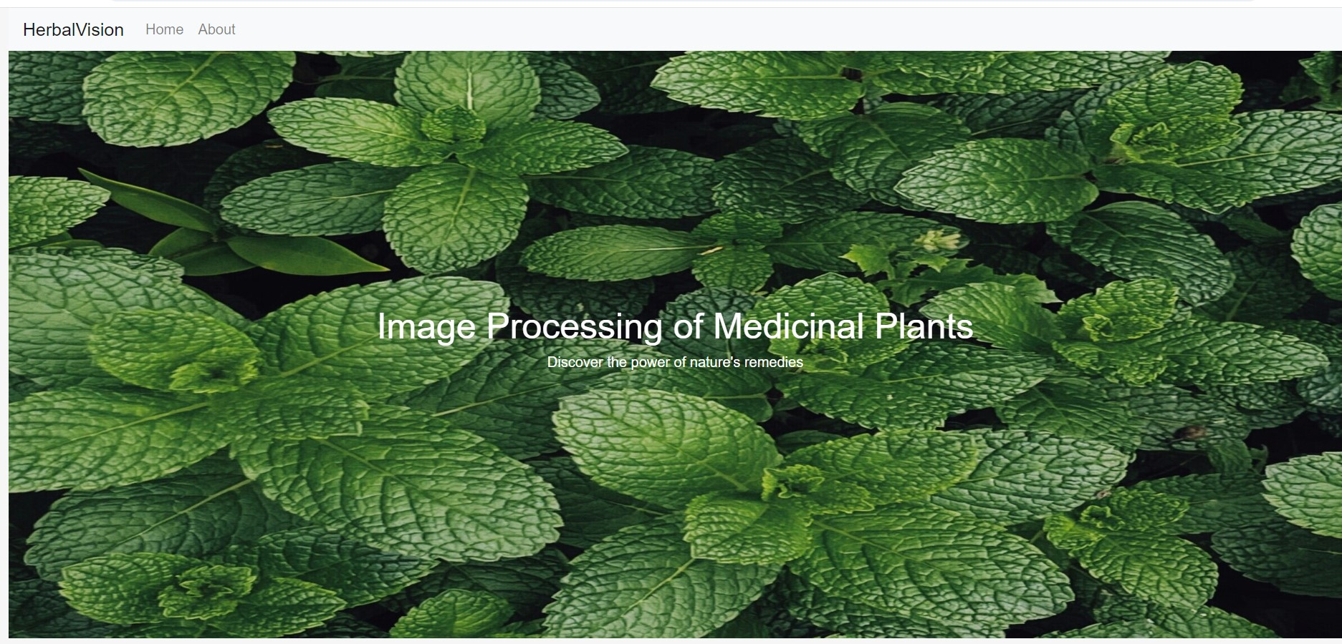
IMPLEMENTATION

Slide 15


Slide 16
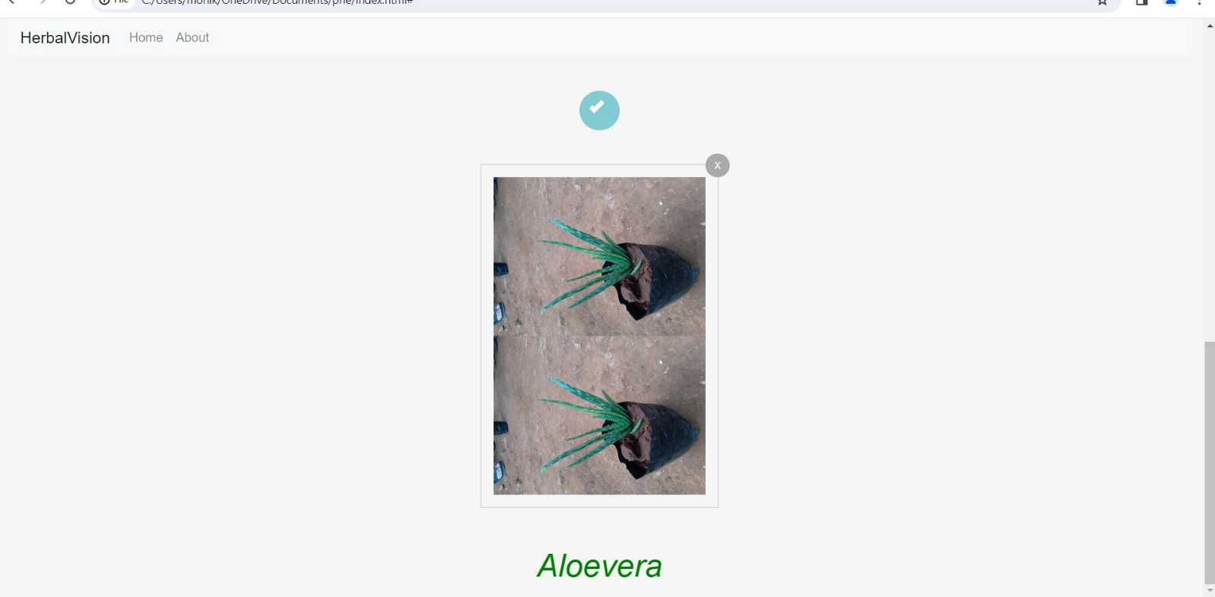

Slide 17
RESULT AND CONCLUSION
The integration of TensorFlow and Convolutional Neural Networks (CNNs) has significantly advanced the identification and classification of medicinal plants by enabling precise automated species recognition through the evaluation of critical leaf features such as shape, size, color, and texture. Utilizing standardized datasets with diverse leaf samples, CNN models trained with TensorFlow can identify intricate patterns and attributes with remarkable accuracy, often exceeding 80%. This approach streamlines the identification process, preserves traditional medical knowledge, and provides valuable insights into plant biodiversity. During training, CNNs learn to extract relevant features from images, effectively differentiating between species. Key metrics like training loss and testing loss are monitored to assess and improve model performance. The combination of CNNs and TensorFlow democratizes advanced machine learning tools, fostering collaboration and global knowledge sharing in plant biology, conservation, and traditional medicine, ultimately promoting an inclusive approach to studying and protecting medicinal plant species.

